Slide 1

System Management Tips and Tricks
Mitch Milam
mitch@xrmcoaches.com
@mitchmilam
blogs.infinite-x.net
crmaccelerators.net
xrmcoaches.com

Slide 2
Overview
Reviewing System Maintenance Jobs
Troubleshooting workflow and plugin issues
Managing historical system job information
Monitoring the Windows Event Log
Using CRM Tracing
System Job Editor
User management tricks and tips
E–mail Management

Slide 3
System Jobs Management

Slide 4
Reviewing System Maintenance Jobs
Build Personal Views
Monitor system jobs on a regular basis
Take action to correct issues

Slide 5
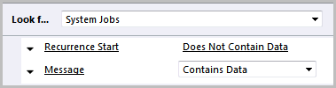
Personal View #1
System Jobs with Messages

Slide 6
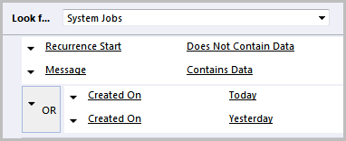
Personal View #2
System Jobs with Messages (Recent)

Slide 7

Personal View #3
System Jobs (Canceled or Failed)

Slide 8
Error Examples

Slide 9
Error Examples

Slide 10
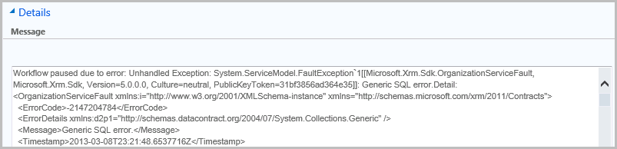
Error Examples

Slide 11

Error Examples

Slide 12

Error Examples

Slide 13
Error Examples

Slide 14
Error Examples

Slide 15
Error Examples

Slide 16
Error Examples

Slide 17
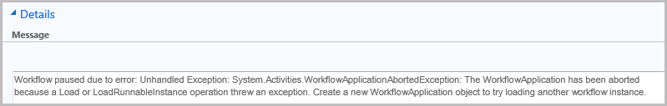
Error Examples

Slide 18
Error Examples

Slide 19
Reviewing System Maintenance Jobs: SQL
Monitor the CorrelationId and Depth fields
Is the Depth > 1?
Is there a single CorrelationId for multiple records?

Slide 20
Reviewing System Maintenance Jobs
Cleanup

Slide 21
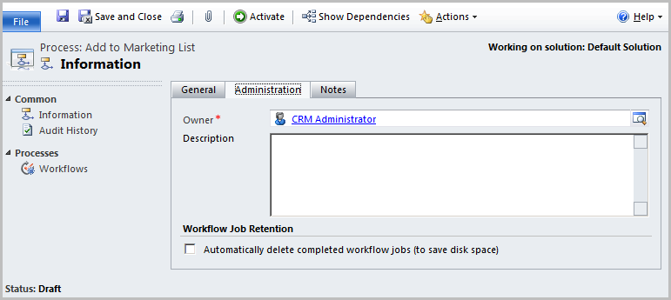
System Job Management: Workflow Execution
Auto-delete successfully completed workflows

Slide 22
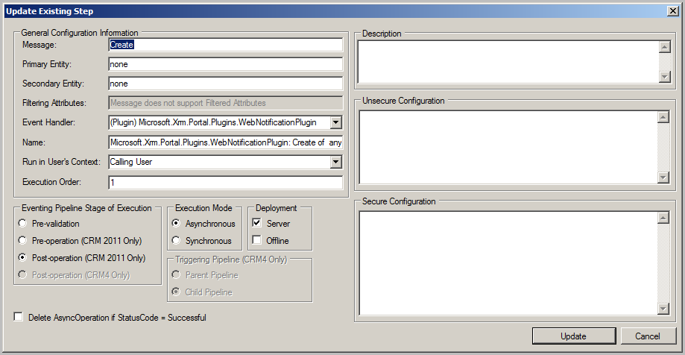
System Job Management: Plugin Execution
Auto-delete successfully completed asynchronous plugin steps

Slide 23
System Job Management: Registry
Article: The AsyncOperationBase and WorkflowLogBase tables grow very large and performance issues occur when you use many workflows in Microsoft Dynamics CRM 4.0
http://support.microsoft.com/kb/968755

Slide 24
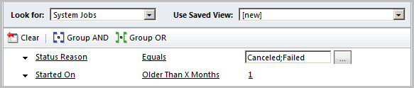
System Job Management: Bulk Delete
Remove canceled or failed jobs

Slide 25
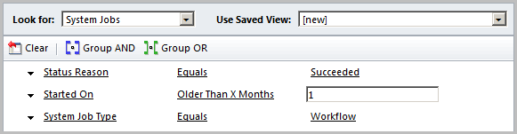
System Job Management: Bulk Delete
Remove successful workflows

Slide 26
System Job Management: SQL Cleanup
Article: Performance is slow if the AsyncOperationBase table becomes too large in Microsoft Dynamics CRM
http://support.microsoft.com/kb/968520

Slide 27
Windows Event Log

Slide 28
Monitoring the Windows Event Log
Monitor the Application Event Log
Filter on Warnings and Errors
Examine each looking for problems and patterns.

Slide 29
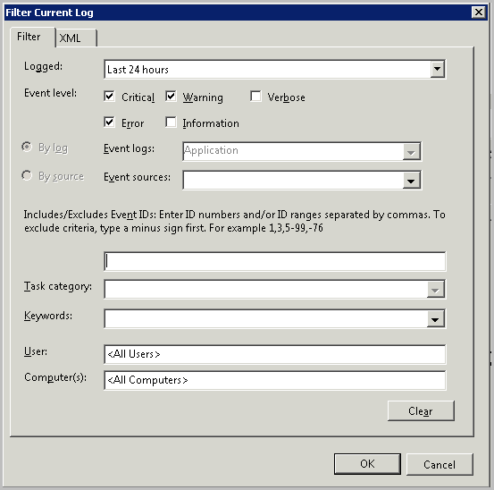
Windows Event Log Filtering

Slide 30
CRM Event Tracing

Slide 31
Using CRM Tracing
Article: How to enable tracing in Microsoft Dynamics CRM
http://support.microsoft.com/kb/907490
Diagnostics Tool for Microsoft Dynamics CRM 2011
http://crmdiagtool2011.codeplex.com/
Trace Log Viewer
http://www.stunnware.com/crm2/topic.aspx?id=tracelogviewer

Slide 32
Using CRM Tracing
Troubleshooting Actions
Turn on Tracing
Reproduce the error
Review the trace log

Slide 33
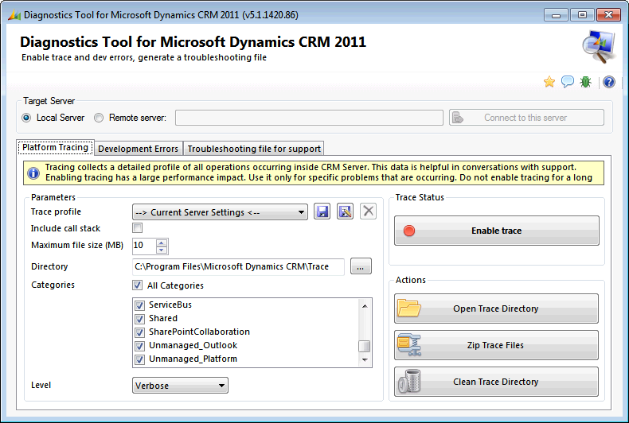
Using CRM Tracing: Diagnostics Tool

Slide 34
Using CRM Tracing
Match Error Codes
Reference number for administrators or support: #7729DCC1

Slide 35
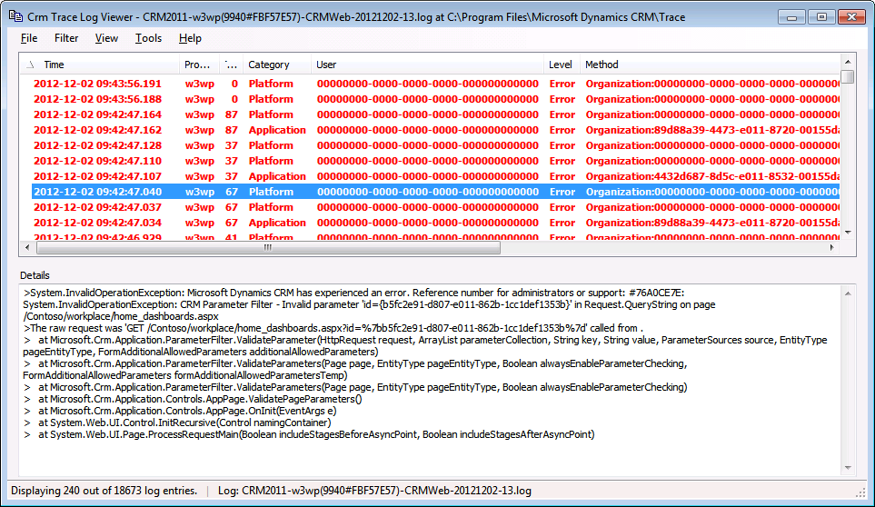
Using CRM Tracing: Log Viewer

Slide 36
SQL System Jobs

Slide 37
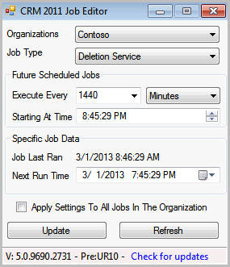
CRM 2011 System Job Editor

Slide 38
CRM 2011 System Job Editor
Reschedule the system jobs to off-hours
Article: More juicy details on Dynamics CRM 2011 Asynchronous Service’s maintenance jobs
http://blogs.msdn.com/b/crminthefield/archive/2013/02/07/more-details-on-dynamics-crm-2011-async-service-maintenance-jobs.aspx

Slide 39
User Management

Slide 40
User management tricks and tips
System Views
Disabled users consuming licenses
Users with no assigned security roles
Users: Primary E-Mail (Pending Approval)

Slide 41
Personal View – Enabled Users (Detail)
Full Name
Primary E-mail
E-mail 2
Business Unit
Access Mode
License Type
Restricted Access
Incoming E-mail Delivery Method
Outgoing E-mail Delivery Method
Primary E-mail Status

Slide 42
E–Mail

Slide 43
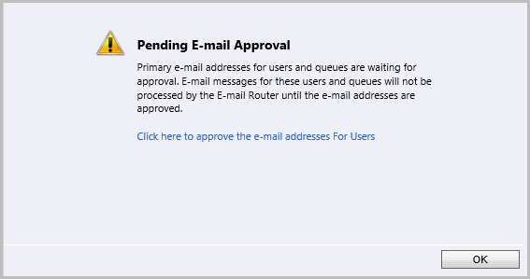
E–Mail

Slide 44
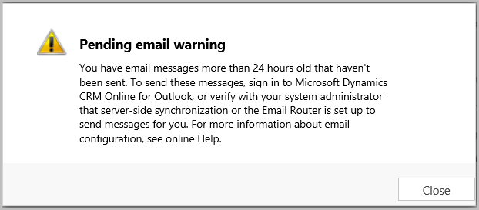
E–Mail

Slide 45
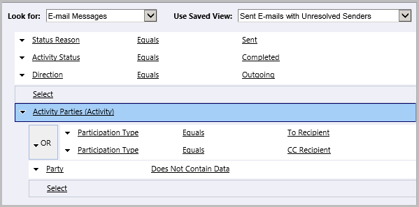
E–Mail Monitoring
E-mails with unresolved senders

Slide 46
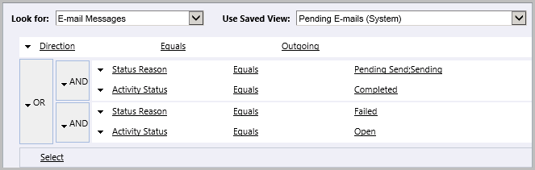
E–Mail Monitoring
Pending E-mails

Slide 47
Q and A
Questions?

